Slide 1
Department of Computer Engineering
Project Presentation on: Deep Learning
Project Title: “LEAF DISEASE DETECTION USING CNN”

Slide 2
Abstract :
The project presents plants leaf disease detection using deep learning techniques for automated vision system used at agricultural field.
Plant diseases are important factor as they result in serious reduction in quality and quantity of agriculture products.
We propose a deep learning based approach that automates the process of classifying the leaves diseases. In particularly, we make use of convolutional neural network to classify image datasets.
The preliminary result demonstrate the effectiveness of the proposed approach even under challenging conditions such as illumination, complex back ground, different resolution, size, pose, and orientation of real scene image

Slide 3
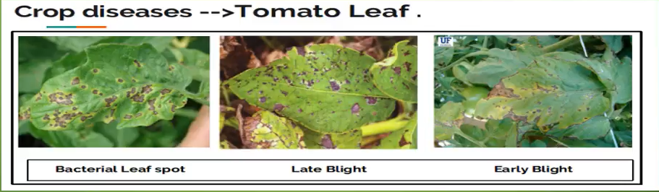
Introduction
They look the same and almost similar. In case the farmer makes wrong predictions and uses the wrong fertilizers or more than the normal dose (or)threshold or Limit (every plant has some threshold fertilizers spraying to be followed), it will mess up the whole plant (or) soil and cause enough damage to plant and fields .

Slide 4
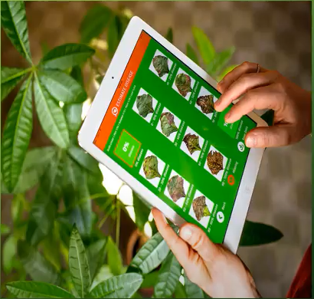
Introduction
Traditionally, Identification of plant diseases has relied on human annotation by visual inspection and the agricultural production cost can be significantly increased if plants diseases are not detected and cured in their early stages using CNN model.
So, to train a model by given image dataset with classify the disease type of leaves.

Slide 5
Existing system
Leaf disease detection plays a vital role in agricultural field.
However, It requires huge manpower, more processing time and extensive knowledge about plants disease. Hence, machine learning is applied to detect disease in plant leaves are into consideration for classification
The morphological feature and properties like color, intensity and dimensions of the plant leaves are taken into consideration for classification.
It presents an overview on various types of plants disease and different classification techniques in machine learning that are used for identifying diseases in different plant leaves.

Slide 6
Disadvantages of existing system
It has not focused on identification of mulberry leaves.
It has not focused on increasing the recognition rate and classification accuracy of severity of leaf diseases.
There is a lack of disease area segmentation and classification.

Slide 7
Proposed system
We planned to design deep learning technique so that a person with lesser expertise in software also be able to use it easily.
It explains about the experimental analysis of our methodology and uses CNN technique.
Samples of different plants leaves images are collected that comprised of different plant diseases like Aster Yellows, Clubroot, Leaf blister etc.
Different number of images is collected for each disease that was classified into database image and input images.

Slide 8
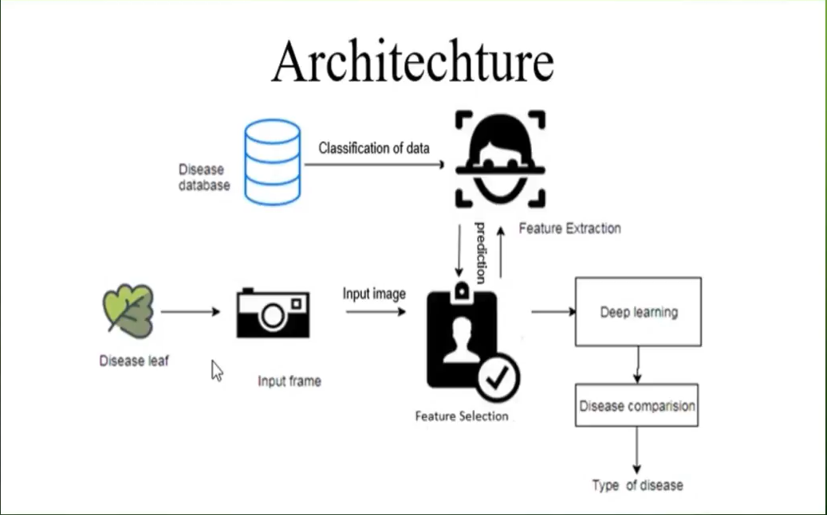

Slide 9
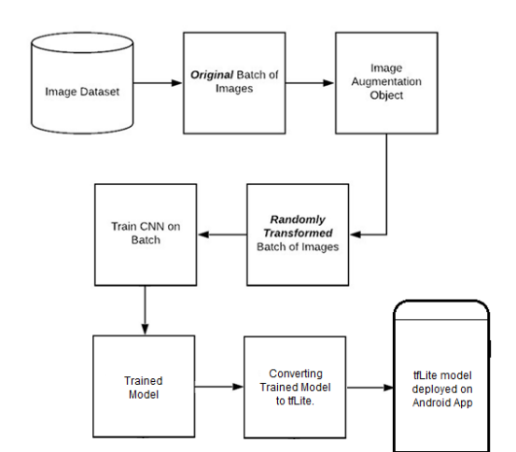
Block Diagram

Slide 10
Working
Some leaves are taken as input, and it is pre-processed for the improvement of image to remove the unwanted distortion for feature processing.
In the feature extraction the shape, color & texture is identified.
Database consists of many images with healthy and unhealthy leaves and the images are trained to identify the particular image from the database.
In Neural Network (NN) classification the leaf is recognized whether the leaf is normal or abnormal.
If the leaf is abnormal the defect region is classified.
The affected area and type of bacteria are identified in the result.

Slide 11
Convolutional neural network
In deep learning, a convolutional neural network (CNN) is a class of artificial neural network, most commonly applied to analyze visual images.
A Convolutional Neural Network (CNN) is a Deep Learning algorithm which can take in an input image, assign importance to various objects in the image and be able to differentiate one from another. The pre-processing required in a CNN is much lower as compared to other classification algorithms.
It is well known for its widely used in applications of image and video recognition and also in recommender systems and Natural Language Processing(NLP).However, convolutional neural network is more efficient because it reduces the number of parameters which makes different from other deep learning models.

Slide 12
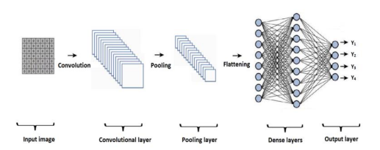
CONVOLUTIONAL NEURAL NETWORK ARCHITECTURE (VGG-19)
Convolutional neural networks have three layers:
The convolutional layer
The pooling layer
All layers.

Slide 13
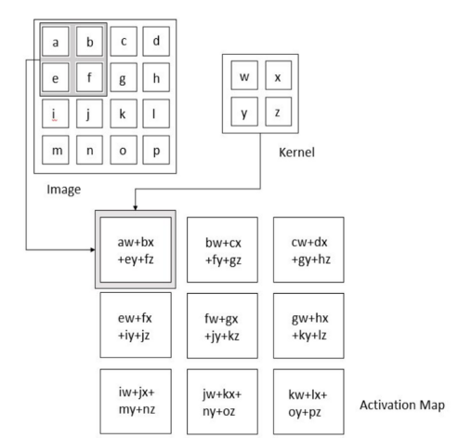
Convolution Layer
Convolutional layer: Create a functional map by scanning the image several pixels at once with filters. Figure 3 shows the inner workings of the convolution process.

Slide 14
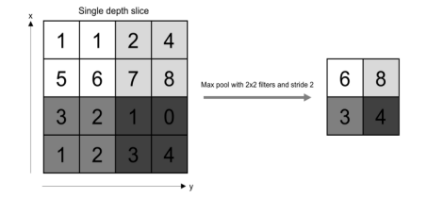
Pooling Layer
Pooling tiers: reduce the amount of data generated by convolutional tiers for more storage. Figure 4 shows the inner workings of this layer.

Slide 15
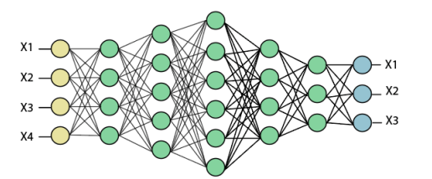
Fully Connected Layer
Fully connected input layer- the output of the previous layer is "flattened" and converted into a vector that is used as the input of the next stage.
The first fully connected layer- add weight to the feature analysis input to correctly predict the tag.
Fully connected output layer- gives the result of each label. Figure 5 shows the inner workings of the fully connected system.

Slide 16
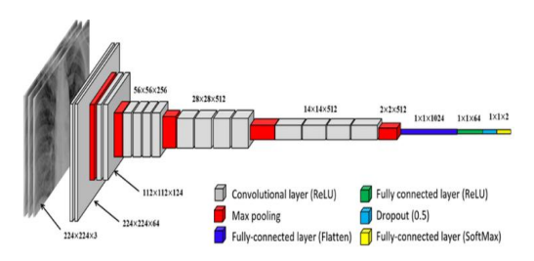
Vgg-19
VGG19 is a sophisticated CNN with pre-trained methods and understanding how images are interpreted in terms of form, color and pattern. VGG19 is a deep neural network that learns millions of images for complex classification problems.

Slide 17
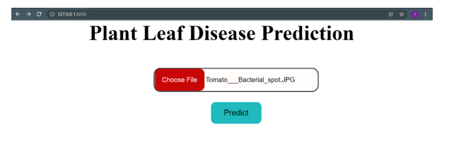
Result

Slide 18
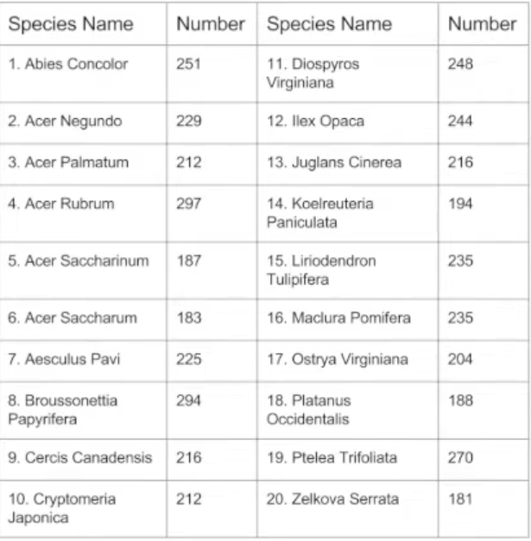
Dataset
The dataset is from Leafsnap:http://leafsnap.com/dataset/
Choose the first 20 species with largest number of pictures
Training set: 80% of each species; 3609 in total
Test set: 20% of each species; 912 in total

Slide 19
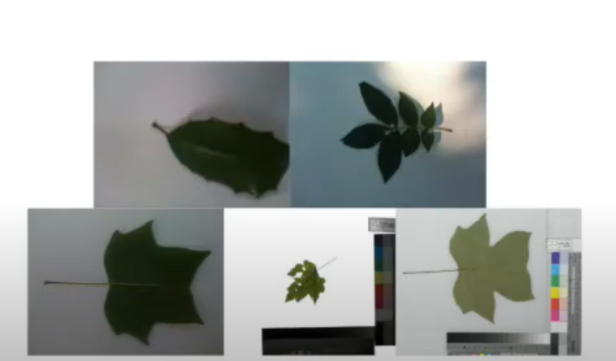
Dataset
Photos are taken indifferent situations and sizes, containing varying amounts of blur, mise, illumination patterns shadows, etc.

Slide 20
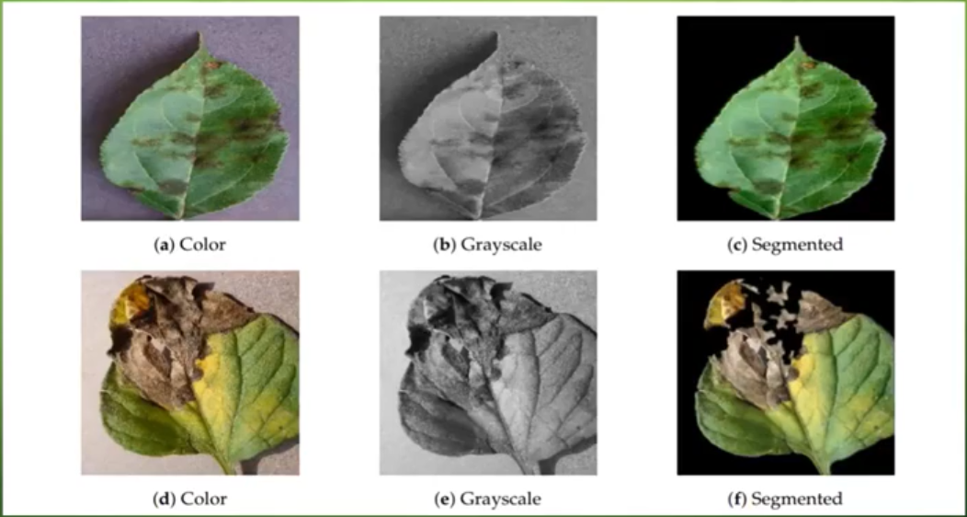
Sample Image of Color, Greyscale, Segment Version of leaf image Dataset.

Slide 21
Modules Description
Training module:
• Feature Extraction extracts all the images of leaf i.e. input.
• Feature selection performance disease classification from the disease database.
• Disease database contain all the various diseases of the leaf.
• Thousand of different leaf dataset will be trained.

Slide 22
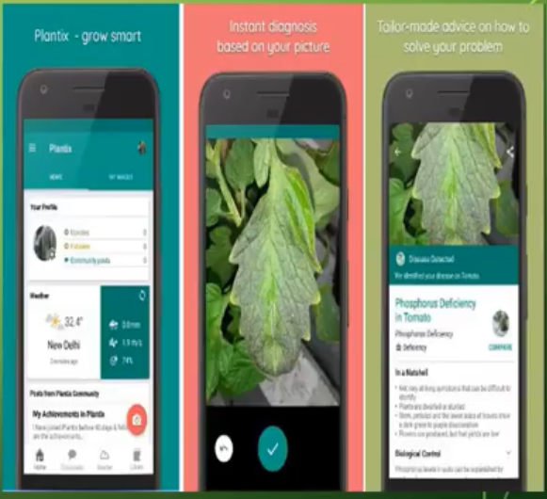
Testing module
• Deep learning is part of a broader family learning methods based on artificial neural networks with representation learning
• Using deep learning. It compares the diseases from the feature selection classification to find the type of disease that leaf has.

Slide 23
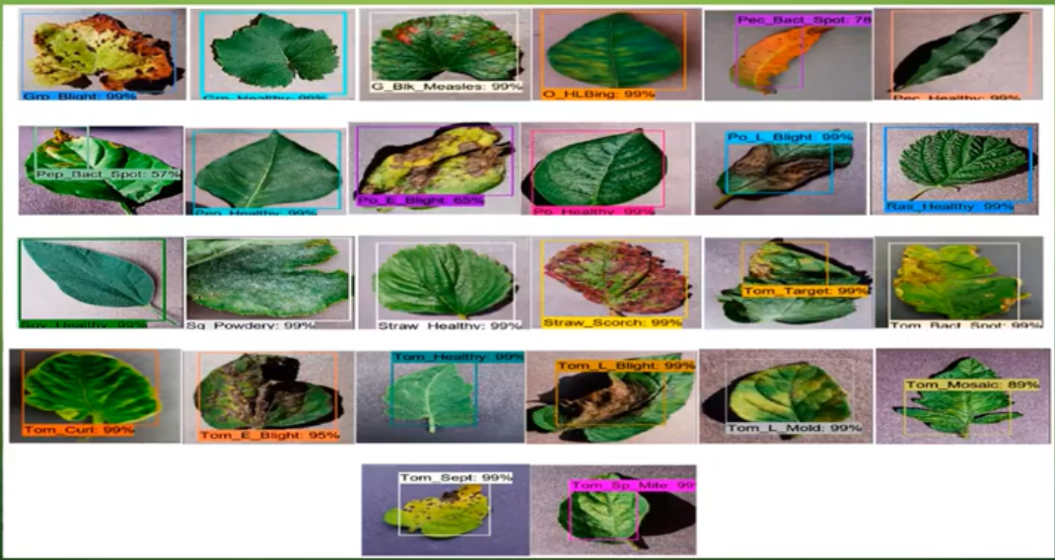
Sample of a leaf

Slide 24



Hardware Requirements
Operating System:
Windows/Linux
Simulation Tool:
Anaconda with Jupyter Notebook

Slide 25

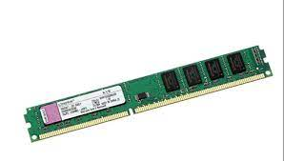

Software Requirements
Processor:
Pentium 4/3
Hardware:
Minimum 80 GB
RAM:
Minimum 2GB

Slide 26
Conclusion
Plant Diseases are major food threats that should have to overcome before it leads to further loss of the entire field. But often framers unable to distinguish between similar symptoms but ace different diseases. This will mislead to wrong or overdosage of fertilizers. Here, we employ Convolutional Neural Network (CNN)called Deep Learning Algorithms to reduce this loss and guide farmers with video lessons. This can be done through mobile App "Not all farmers but some do use it."

Slide 27


Thankyou

